Slide 1
4. Review of Basic Probability and Statistics
Outline:
4.1. Random Variables and Their Properties
4.2. Simulation Output Data and Stochastic Processes
4.3. Estimation of Means and Variances
4.4. Confidence Interval for the Mean
© Copyright 1998-2006 by Averill M. Law. All rights reserved.

Slide 2
4.1. Random Variables and Their Properties
A random variable X is said to be
discrete if it can take on at most a countable number of values, say,
x₁, x₂, ... . The probability that X is
equal to x_{i} is given by
and

Slide 3
where p(x) is the probability mass function. The distribution function F(x) is
for all -∞ < x < ∞.

Slide 4
Example 4.1: Consider the demand-size random variable of Section 1.5 of Law (2006) that takes on the values 1, 2, 3, 4, with probabilities 1/6, 1/3, 1/3, 1/6. The probability mass function and the distribution function are given in Figures 4.1 and 4.2.

Slide 5
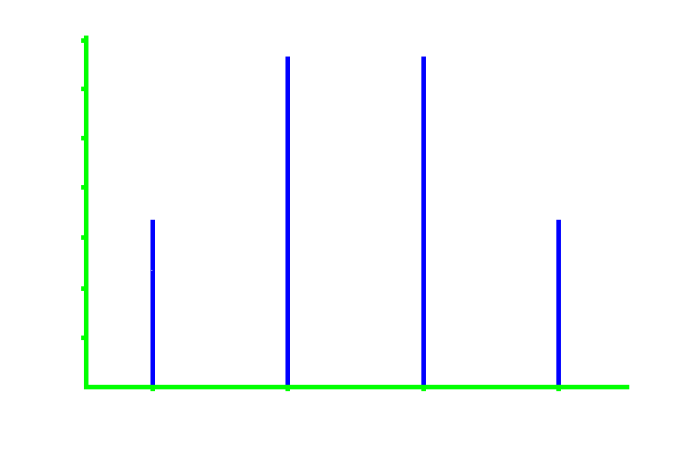
p(x)
0.35
0.30
0.25
0.20
0.15
0.10
0.05
0.00
x
1
2
3
4
Figure 4.1. p(x) for the demand-size random variable.

Slide 6
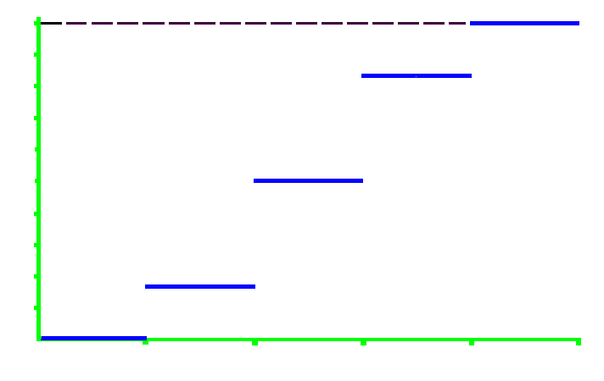
F(x)
1.0
0.9
0.8
0.7
0.6
0.5
0.4
0.3
0.2
0.1
0.0
x
0
1
2
3
4
5
Figure 4.2. F(x) for the demand-size random variable.

Slide 7
A random variable X is said to be continuous if there exists a nonnegative function f(x), the probability density function, such that for any set of real numbers B,
(where “∈” means “contained in”).

Slide 8
If x is a number and ∆x > 0, then
which is the left shaded area in Figure 4.3.

Slide 9
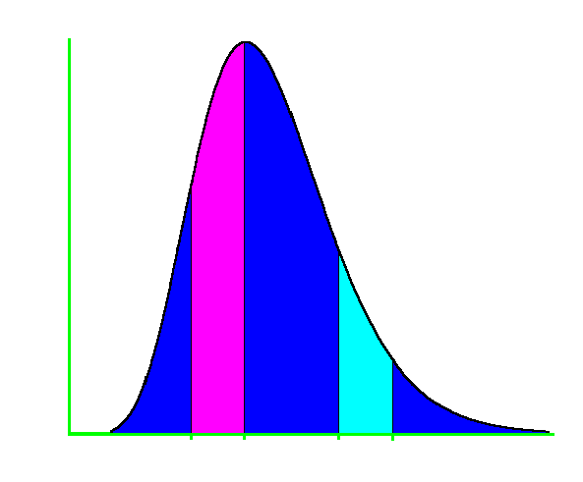






f(x)
x
Figure 4.3. Interpretation of the probability density function f(x).

Slide 10
The distribution function F(x) for a continuous random variable X is

Slide 11
Example 4.2: The probability density function and distribution function for an exponential random variable with mean β are defined as follows (see Figures 4.4 and 4.5):
and

Slide 12
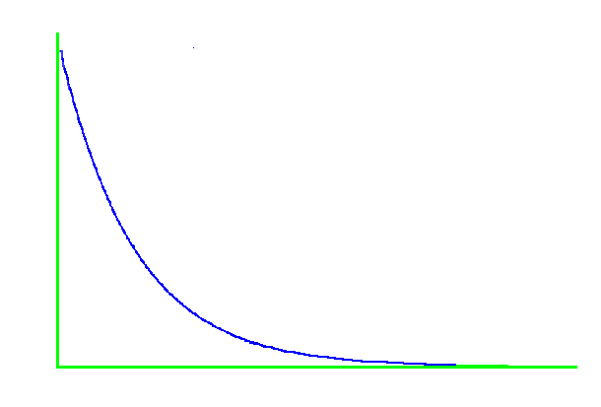

f(x)
x
0
Figure 4.4. f(x) for an exponential random variable with mean β..

Slide 13
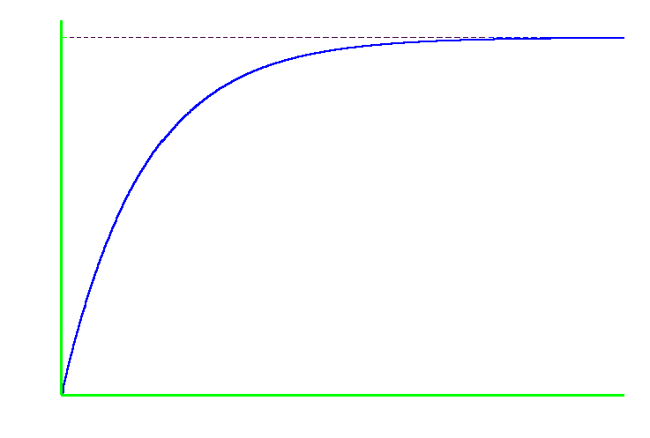
F(x)
1
0
x
Figure 4.5. F(x) for an exponential random variable with mean β.

Slide 14
The random variables X and Y are independent if knowing the value that one takes on tells us nothing about the distribution of the other.
The mean or expected value of the random variable X, denoted by μ or E(X), is given by

Slide 15
The mean is one measure of the central tendency of a random variable.
Problem 4.1: What are other measures?
Properties:
1. E(cX) = cE(X), where c is a constant
2. E(X + Y) = E(X) + E(Y) regardless of
whether X and Y are independent

Slide 16
The variance of the random variable X, denoted by σ² or Var(X), is given by
σ² = E[(X - μ)²] = E(X²) - μ²
The variance is a measure of the dispersion of a random variable about its mean (see Figure 4.6).

Slide 17
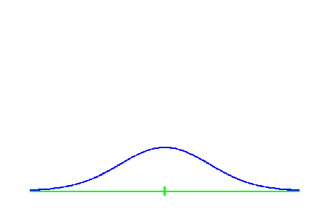
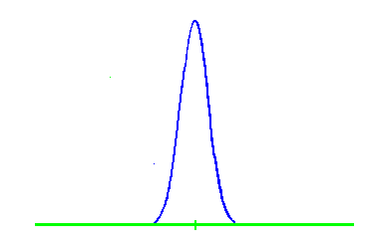
σ²
large
σ²
small
X
X
X
X
µ
µ
Figure 4.6. Density functions for continuous random variables with large and small variances.

Slide 18
Properties:
1. Var(cX) = c²Var(X)
2. Var(X + Y) = Var(X) + Var(Y)
if X, Y are independent

Slide 19
The square root of the variance is called the standard deviation and is denoted by σ. It can be given the most definitive interpretation when X has a normal distribution (see Figure 4.7).

Slide 20
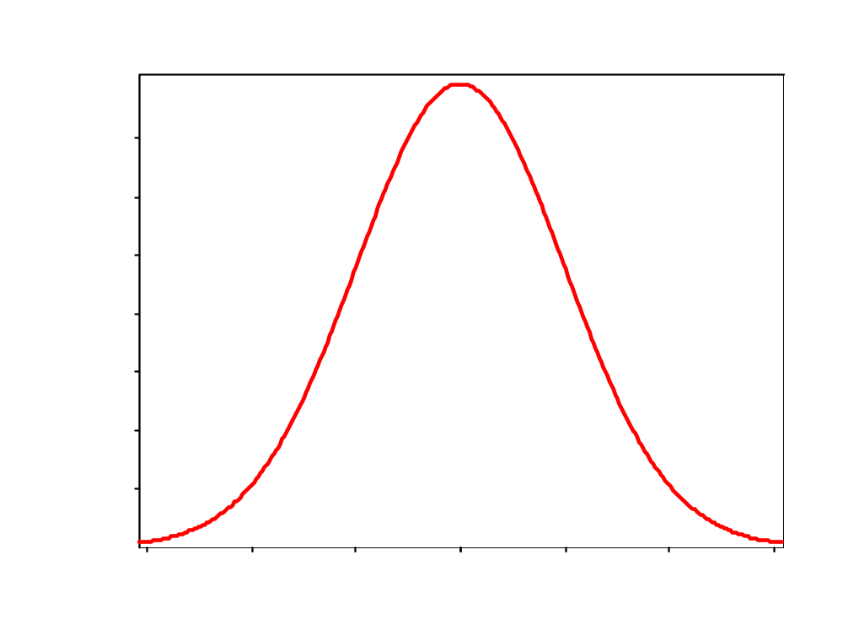





Area = 0.68
Figure 4.7. Density function for a N(μ, σ²) distribution.

Slide 21
The covariance between the random variables X and Y, denoted by Cov(X, Y), is defined by
Cov(X, Y) = E{[X - E(X)][Y - E(Y)]}
= E(XY) - E(X)E(Y)
The covariance is a measure of the dependence between X and Y. Note that Cov(X, X) = Var(X).

Slide 22
Definitions:
Cov(X, Y) X and Y are
= 0 uncorrelated
> 0 positively correlated
< 0 negatively correlated
Independent random variables are also uncorrelated.

Slide 23
Note that, in general, we have
If X and Y are independent, then

Slide 24
The correlation between the random variables X and Y, which is a measure of linear dependence (see next slide), is denoted by Cor(X, Y) and defined by
It can be shown that

Slide 25
Suppose that , where a and b are constants. Then

Slide 26
4.2. Simulation Output Data and Stochastic Processes
A stochastic process is a collection of "similar" random variables ordered over time all defined relative to the same experiment. If the collection is X₁, X₂, ... , then we have a discrete-time stochastic process.

Slide 27
If the collection is {X(t), t ≥ 0}, then we have a continuous-time stochastic process.

Slide 28
Example 4.3:
For the single-server queueing system of Chapter 1, assume the following:
• The A_{i}’s are independent and
identically distributed (IID)
• The P_{i}’s are IID
• The A_{i}’s and P_{i}’s are independent

Slide 29
Relative to the experiment of generating the A_{i}'s and P_{i}'s, one can define the discrete-time stochastic process of delays in queue D₁, D₂, ... as follows:
D ₁ = 0
D_{i +1} = max{D_{i} + P_{i} - A_{i +1}, 0} for i = 1, 2, ...

Slide 30
Thus, the simulation maps the input random variables into the output process of interest.
Problem 4.2: Are D_{i} and D_{i+1} independent, positively correlated, or negatively correlated?

Slide 31
Other examples of stochastic processes:
• N₁, N₂, ... , where N_{i} = number of parts
produced in the ith hour for a
manufacturing system
• T₁, T₂, ... , where T_{i} = time in system of
the ith part for a manufacturing system
• {Q(t), t ≥ 0}, where Q(t) = number of
customers in queue at time t

Slide 32
• C₁, C₂, ... , where C_{i} = total cost in the
ith month for an inventory system
• E₁, E₂, ... , where E_{i} = end-to-end delay
of ith message to reach its destination
in a communications network

Slide 33
Example 4.4: Consider the delay-in-queue process D₁, D₂, ... for the M/M/1 queue with utilization factor ρ. Then the correlation function ρ_{j} between D_{i} and D_{i+j} is given in Figure 4.8.

Slide 34
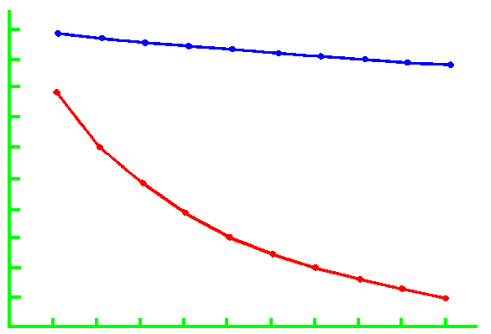
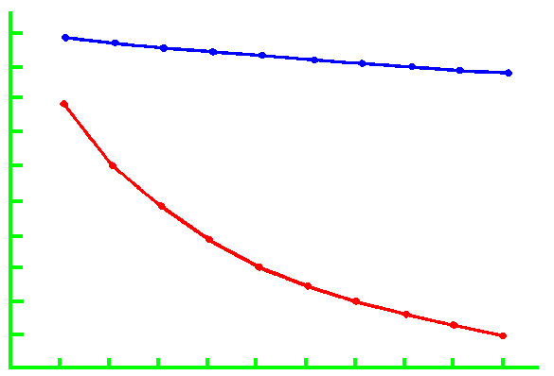
ρ_{j}
ρρ
ρ = 0.9
1.0
0.9
0.8
0.7
0.6
0.5
0.4
ρ = 0.5
0.3
0.2
0.1
j
0
1
2
3
4
5
6
7
8
9
10
Figure 4.8. Correlation function ρ_{j} of the process D₁, D₂, ... for the M/M/1 queue.

Slide 35
4.3. Estimation of Means and Variances
Let X₁, X₂, ..., X_{n} be IID random variables with population mean and variance μ and σ², respectively.

Slide 36
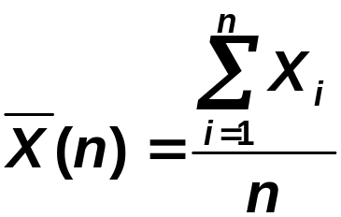

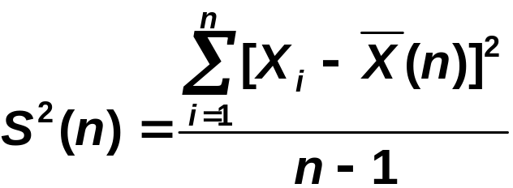

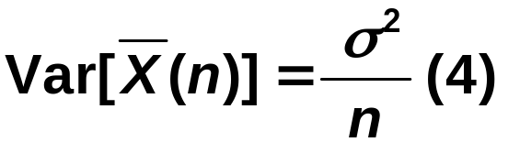
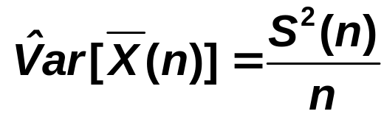


Population Sample estimate
parameter
(1)
Sample mean
Sample variance
(3)
(5)
Note that is an unbiased estimator of μ, i.e.,

Slide 37
Problem 4.3: Show that is an unbiased estimator of .
The difficulty with using as an estimator of without any additional information is that we have no way of assessing how close is to .

Slide 38
Because is a random variable with variance , on one experiment it may be close to while on another it may differ from by a large amount (see Figure 4.9).
The usual way to access the precision of
as an estimator of is to construct a confidence interval for , which we discuss in the next section.

Slide 39
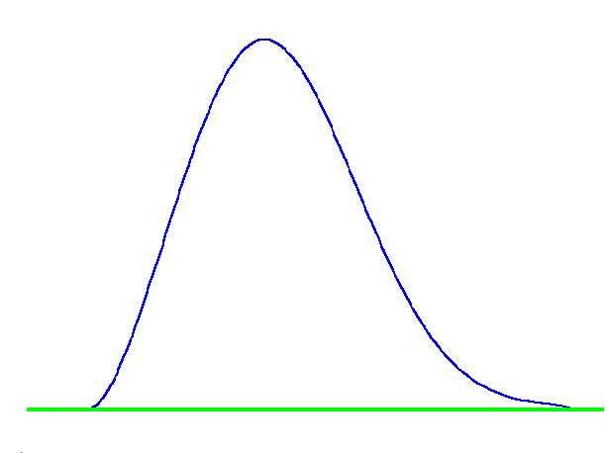



X
X
μ
Figure 4.9. Two observations of the random variable .

Slide 40
Example 4.5: Consider the bank with 5 tellers on p. 486-487 of Law. The following are the average delays in queue resulting from 10 independent replications of the simulation model: 1.53, 1.66, 1.24, …, 2.60
Since these observations are IID, they can be plugged into (1) through (5).

Slide 41
However, the delays in queue from one particular replication are not independent.

Slide 42
4.4. Confidence Interval for the Mean
Let X₁, X₂, ..., X_{n} be IID random variables with mean μ. Then an (approximate) 100(1 - α) percent
(0 < α < 1) confidence interval for μ is

Slide 43
where t_{n - 1, 1 - α/2} is the upper 1 - α/2 critical point for a t distribution with n - 1 df (see Figure 4.10).

Slide 44
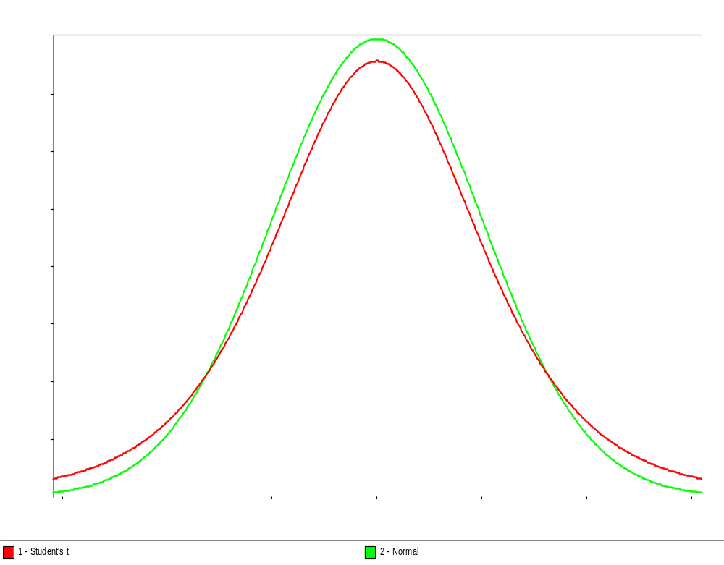




t distribution with n - 1 df
zzz
xxxx
Standard normal
distribution
0
0
0
Figure 4.10. Standard normal distribution and t distribution with n - 1 df.

Slide 45
Notes:
• t_{n-1, 1-α/2} > z_{1-α/2} for n ≥ 2.
• t_{n-1, 1-α/2} decreases to z_{1-α/2} as n gets
larger.
• t_{n-1, 1-α/2} ≈ z_{1-α/2} for n = 50
• As α gets smaller, the confidence
interval half-length gets larger.

Slide 46
Interpretation of a confidence interval:
If one constructs a very large number of independent 100(1 - α) percent confidence intervals for each based on n observations, where n is sufficiently large, then the proportion of these confidence intervals that contain μ should be 1 - α (regardless of the distribution of X).

Slide 47
Alternatively, if X is N(μ,σ²), then the coverage probability will be 1- α regardless of the value of n. If X is not N(μ,σ²), then there will be a degradation in coverage for “small” n. The greater the skewness of the distribution of X, the greater the degradation (see pp. 256-257).

Slide 48
We used t_{n-1, 1-α/2} rather than z_{1-α/2} in (6) to help lessen the effect of skewness in the distribution of X and of “small” n.

Slide 49
Important characteristics of a confidence interval:
• Confidence level (e.g., 90 percent)
• Half-length (see also p. 511)
Problem 4.4: If we want to decrease the half-length by a factor of approximately 2 and n is “large” (e.g., 50), then to what value does n need to be increased?

Slide 50
Recommended reading
Chapter 4 in Law (2006)

